Slide 1




NEXT GEN EMPLOYABILITY PROGRAM
Creating a future-ready workforce
Team Members
College Name
Student Name :SUNDHARAVATHANA.R
Student ID :au912421104046
Shanmuganathan Engineering College

Slide 2

CAPSTONE PROJECT SHOWCASE
Project Title
VOTING APPLICATION USING DJANGO FRAMEWORK
Abstract | Problem Statement | Project Overview | Proposed Solution | Technology Used | Modelling & Results | Conclusion

Slide 3
Abstract: DJANGO ONLINE VOTING SYSTEM We will create a pollster (voting system) web application using Django. This application will conduct a series of questions along with many choices. A user will be allowed to give voting for that question by selecting a choice. Based on the answer the total votes will be calculated and it will be displayed to the user. Users can also check the result of the total votes for specific questions on the website directly. We will also build the admin part of this project. Admin user will be allowed to add questions and manage questions in the application.
Source :

Slide 4
Problem Statement Despite the advancement of technology in various domains, traditional voting systems continue to face challenges such as logistical constraints, limited accessibility, and susceptibility to fraud. In this context, there is a pressing need for the implementation of a secure and efficient online voting system using Django. Key features Accessibility Security Trustworthiness Legal and regularity Usability and User Experienc
Source :

Slide 5
Project Overview Project Title: Pollster (Voting System) using Django framework Type of Application (Category): Web application. Pre-requisite: Knowledge of Python and basics of Django Framework. Python should be installed in the system. Visual studio code or any code editor to work on the application. Technologies used in the project: Django framework and SQLite database which comes by default with Django.
Source :

Slide 6
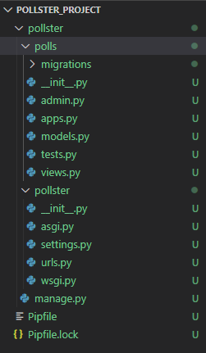
Proposed Solution creating project
.
Source :

Slide 7
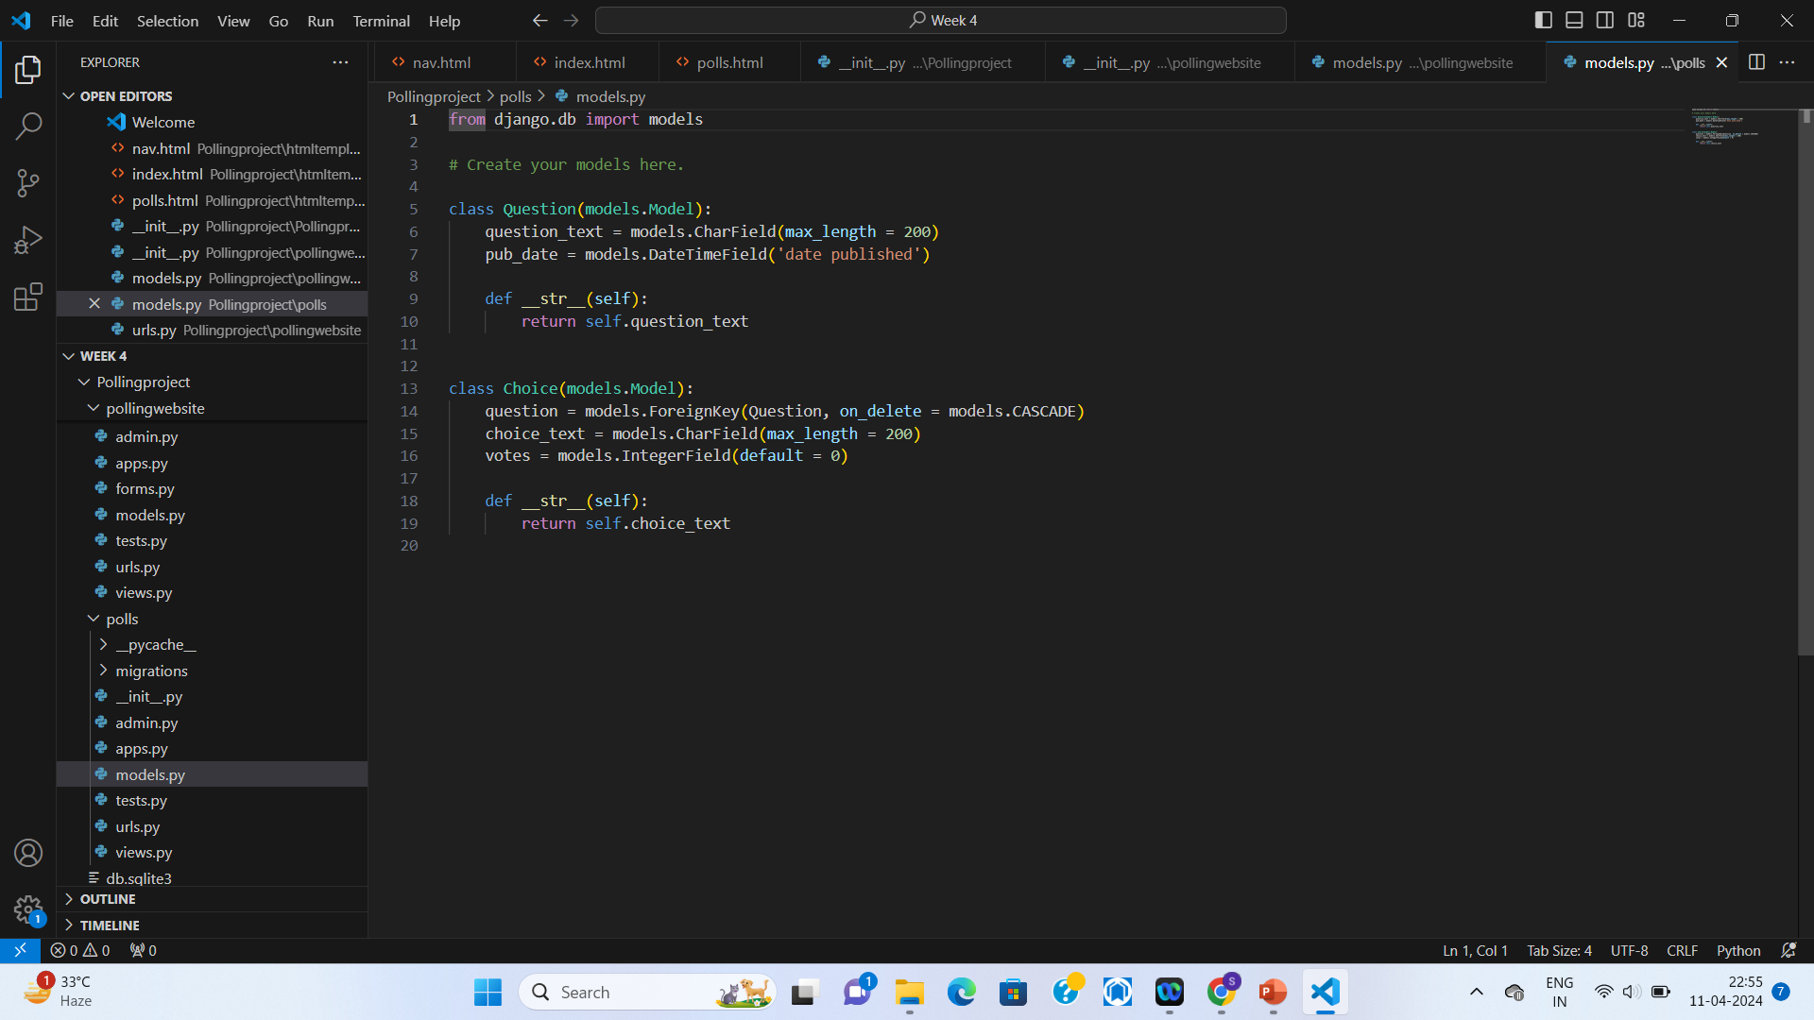
creating models
Source :

Slide 8
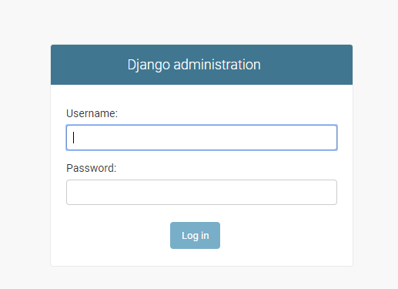
creating admin user
Create views
Create templates
Create landing page
Create routing inside of
the file url.py
Testing of application
Source :

Slide 9


Technology Used
Front-end
Back-end
Source :

Slide 10
Modelling & Results from django.db import models # Create your models here. class Question(models.Model): question_text = models.CharField(max_length = 200) pub_date = models.DateTimeField('date published') def __str__(self): return self.question_text class Choice(models.Model): question = models.ForeignKey(Question, on_delete = models.CASCADE) choice_text = models.CharField(max_length = 200) votes = models.IntegerField(default = 0) def __str__(self): return self.choice_text
Source :

Slide 11
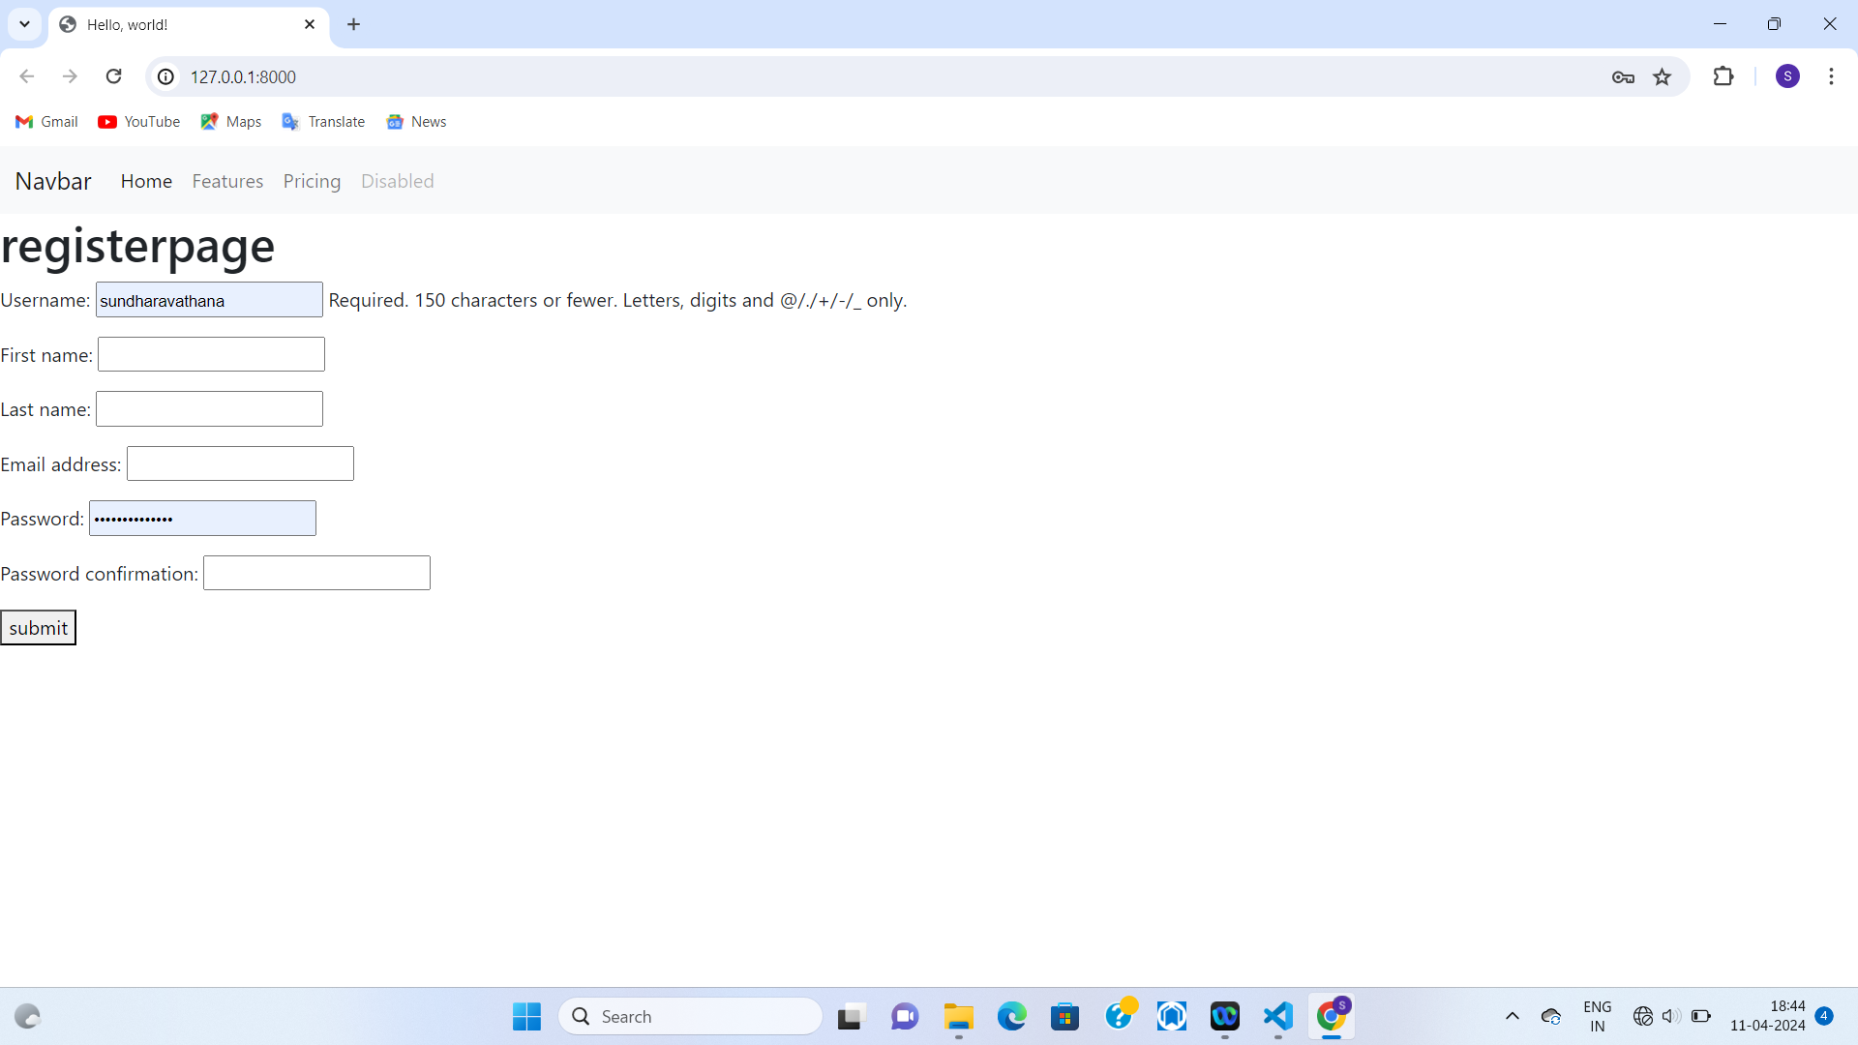
REGISTERATION PAGE

Slide 12
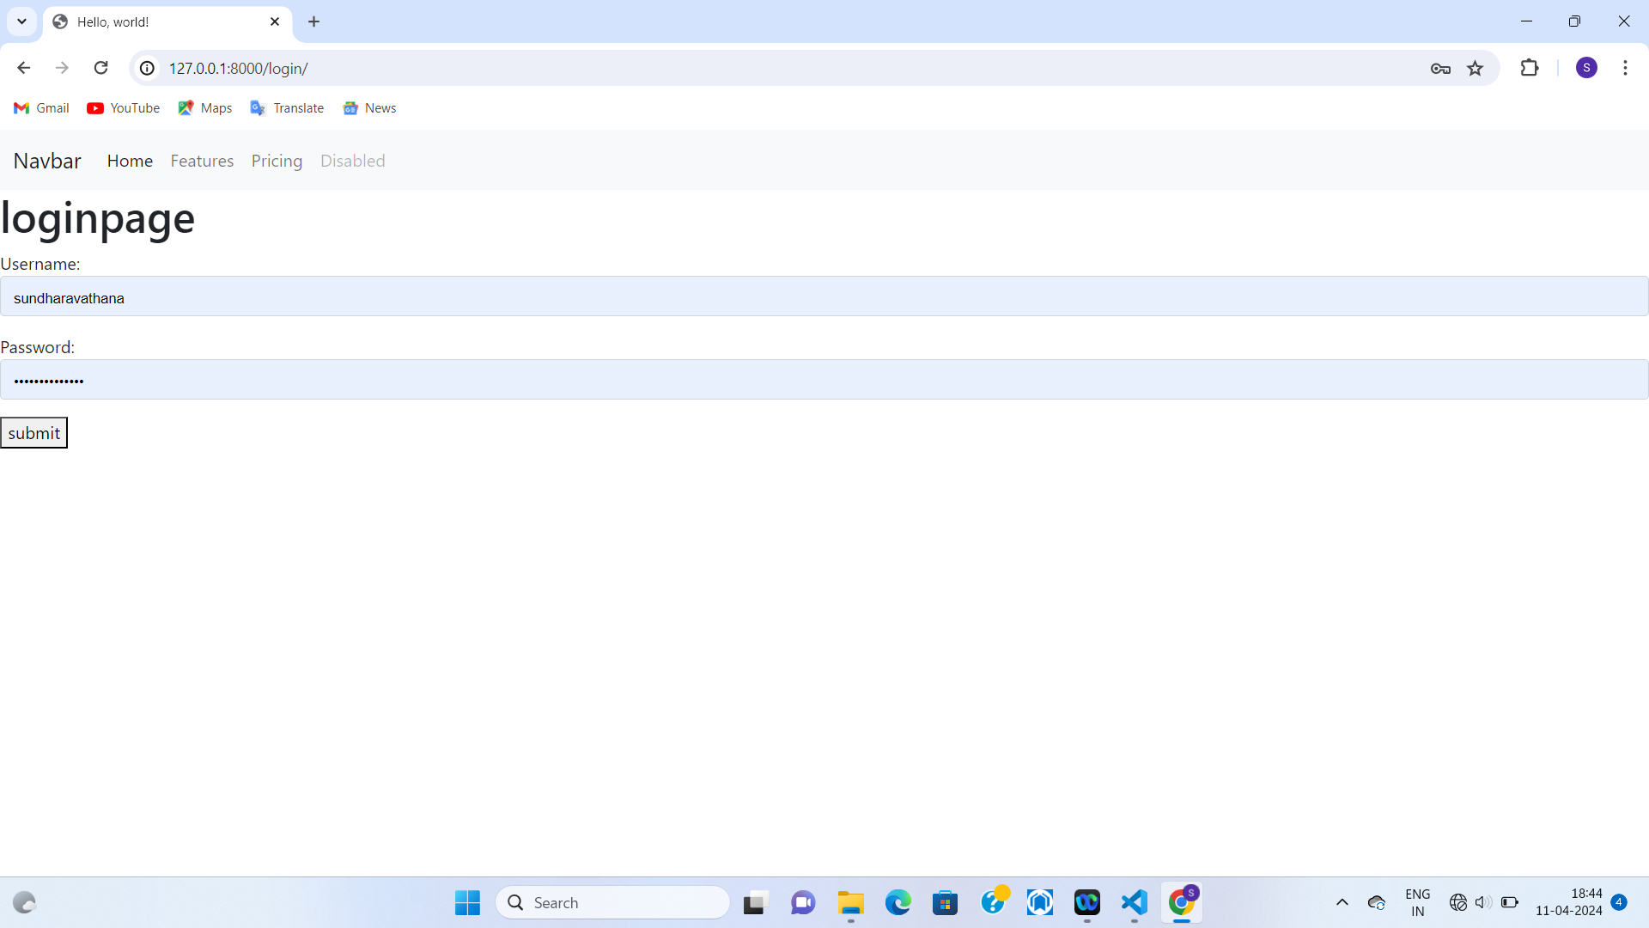
LOGIN PAGE

Slide 13
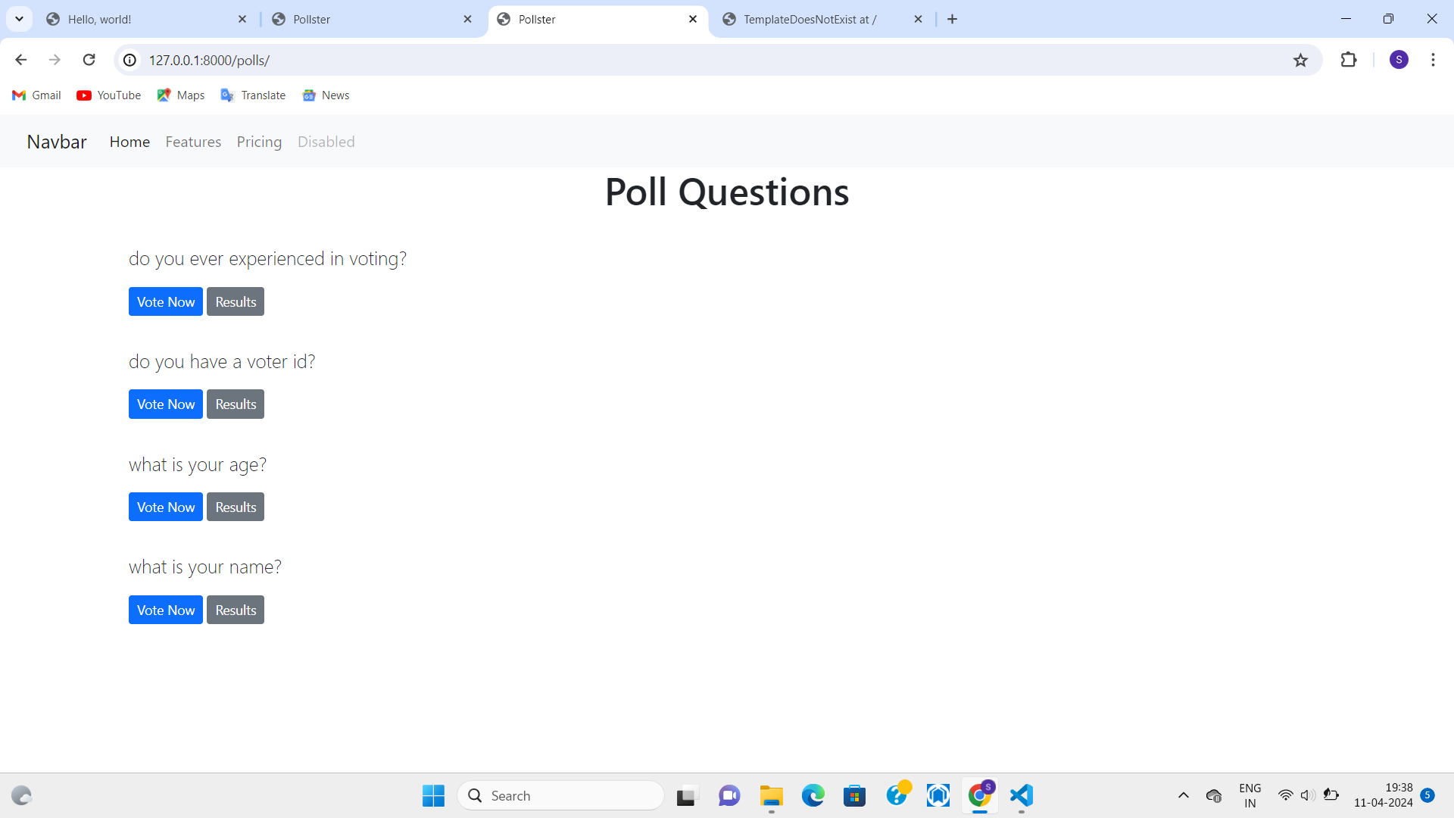
Service-Page

Slide 14
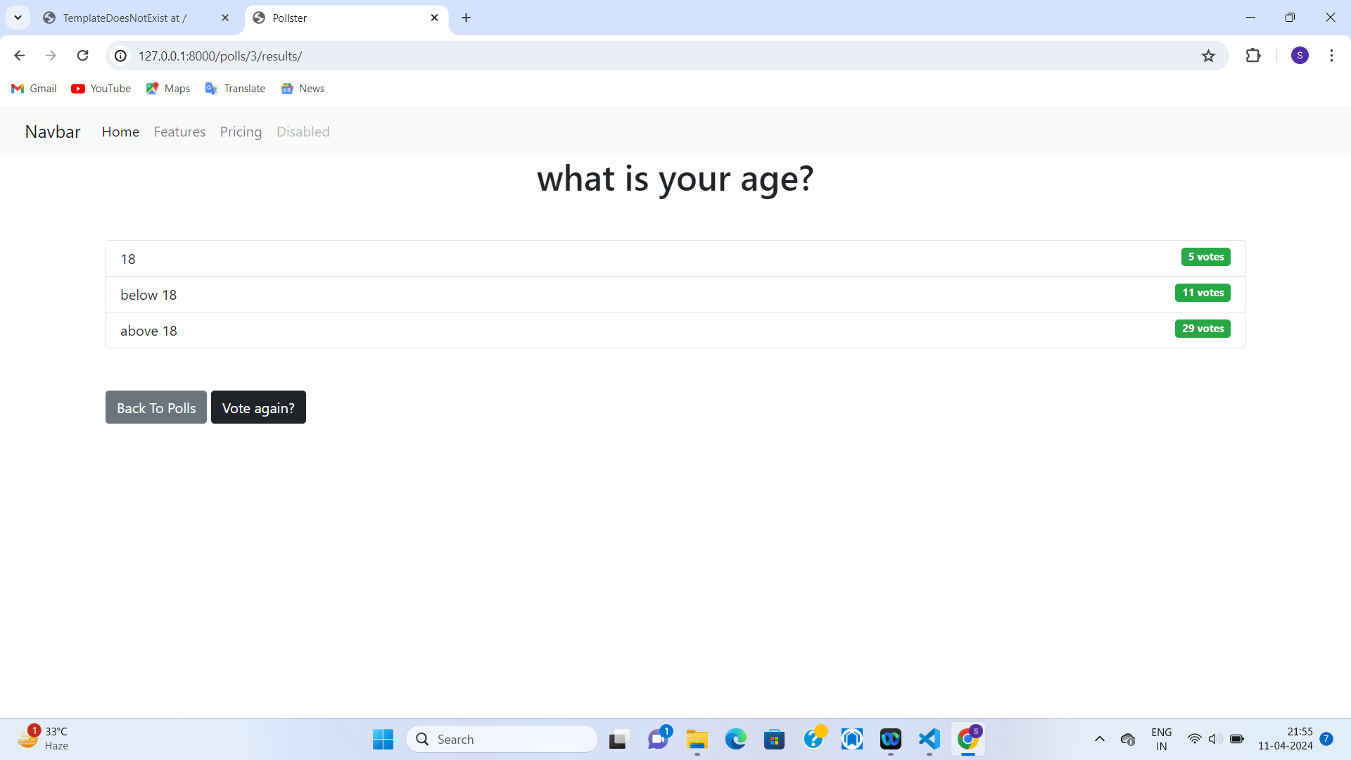
SERVICE PAGES

Slide 15
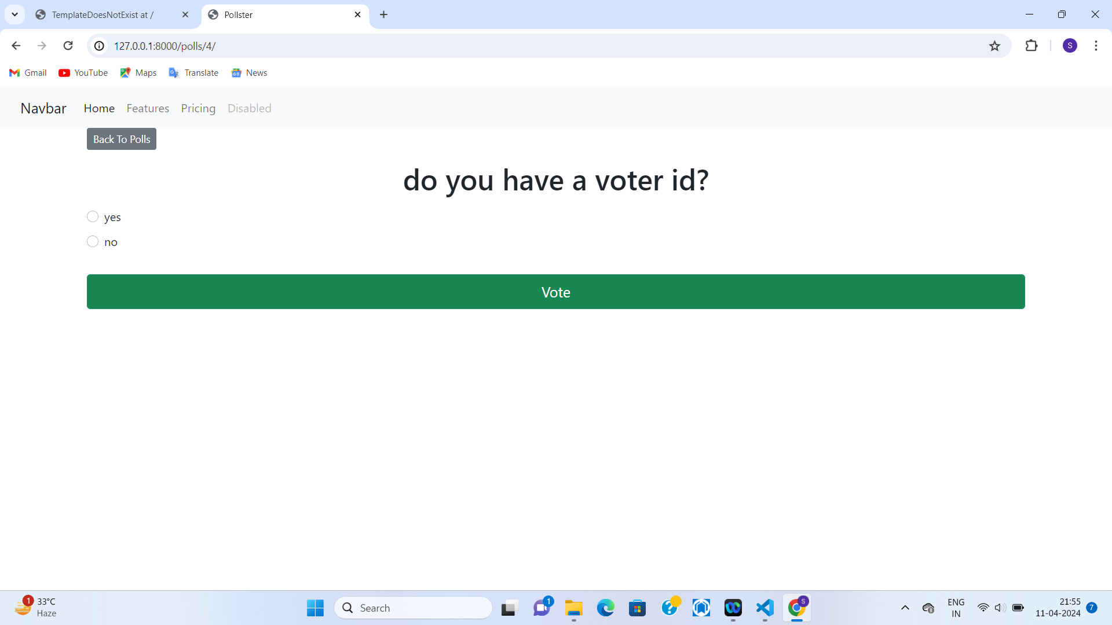

Blog-Page

Slide 16
FUTURE ENHANCEMENT:
User Authentication:
Implement user authentication to allow only registered users to vote.
Associate each vote with a user to prevent duplicate voting.
Multiple Choice Options:
Allow users to select multiple choices for a single poll.
Implement validation to ensure users do not exceed the allowed number of choices.

Slide 17
Conclusion An online voting system built using Django offers numerous advantages in terms of accessibility, convenience, and efficiency. By leveraging the power of web technology, it allows voters to cast their ballots from anywhere with internet access, reducing barriers such as physical distance and time constraints. Additionally, the secure and scalable nature of Django ensures the integrity and reliability of the voting process, safeguarding against potential tampering or fraud.
Source :

Slide 18
Thank You!
Notes:
Thank You !!

